Slide 1
Machine Learning Models
By Ronan Green

Slide 2
Introduction
Models and Datasets Overview
Linear Regression
Decision Tree
Random Forest
Conclusion

Slide 3
Models and Datasets Overview
Random Forest
Model Overview
Datasets Used
Dataset Characteristics
Linear Regression
Model Overview
Datasets Used
Dataset Characteristics
Decision Tree
Model Overview
Datasets Used
Dataset Characteristics

Slide 4
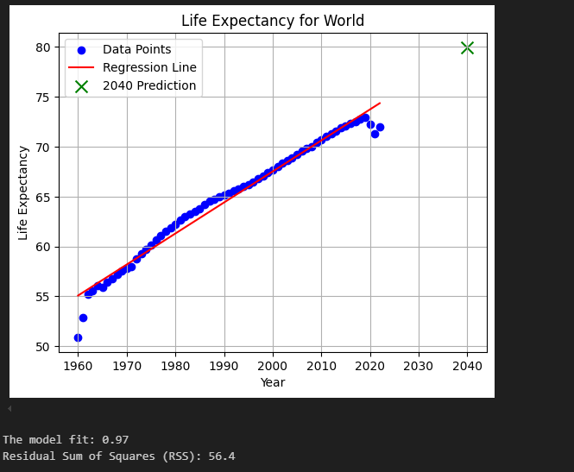
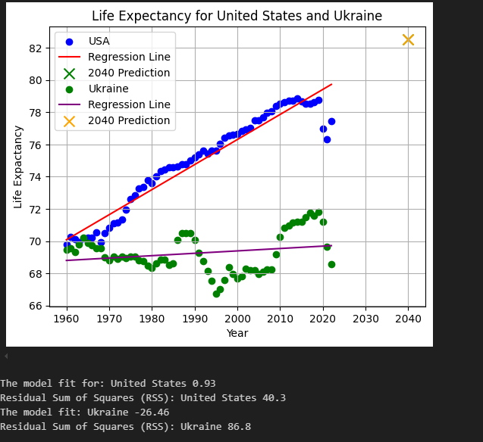
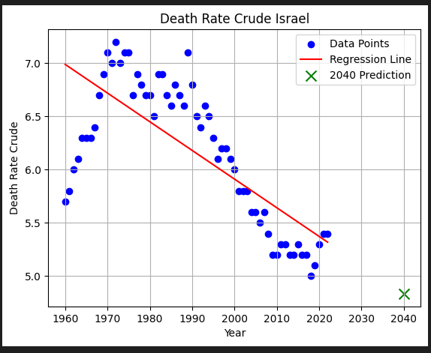
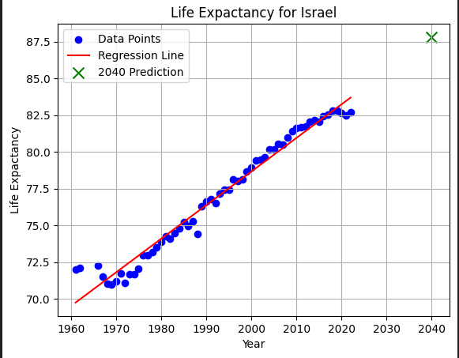
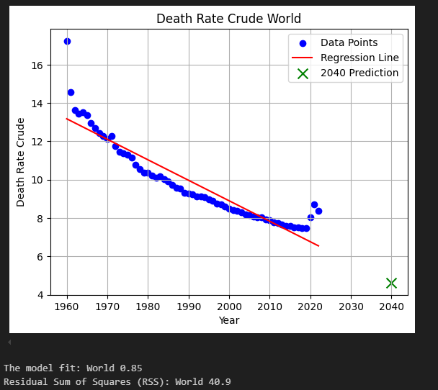
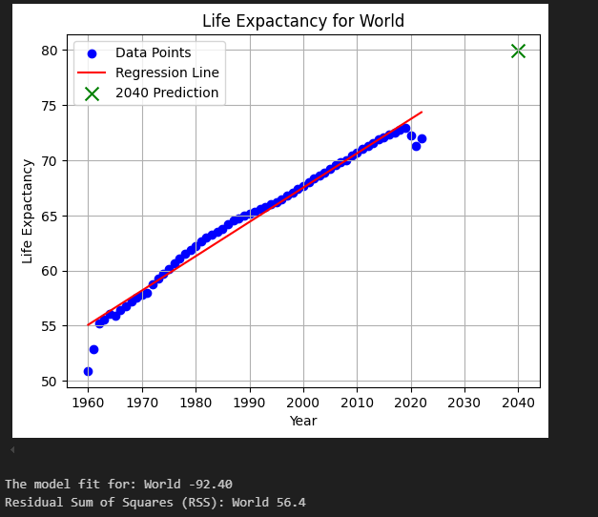
Linear Regression
Pre-Processing
Challenges Faced
Algorithms Used
Findings

Slide 5
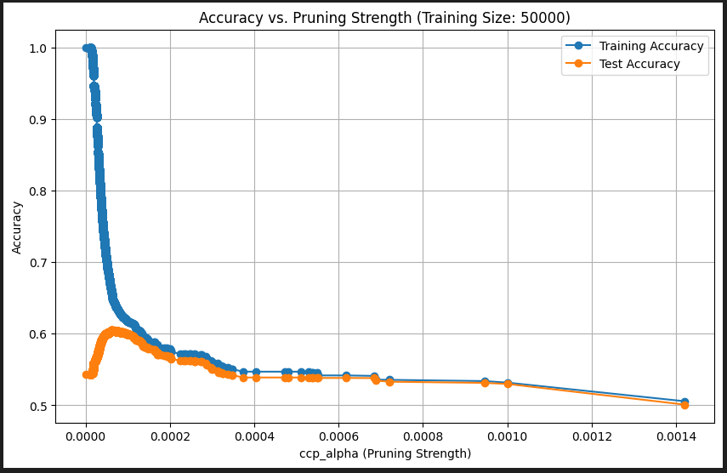
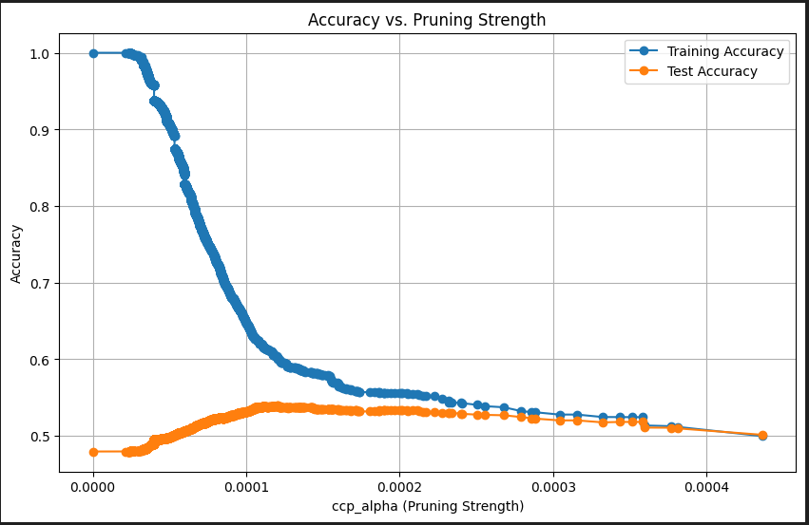
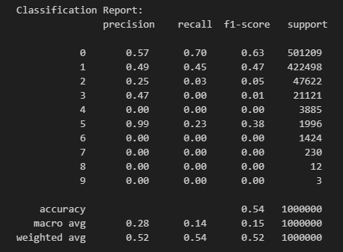
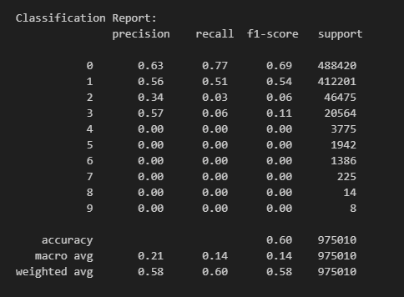
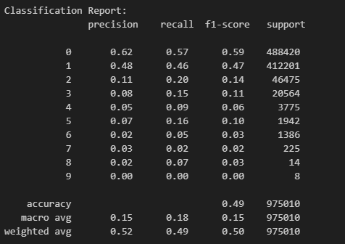
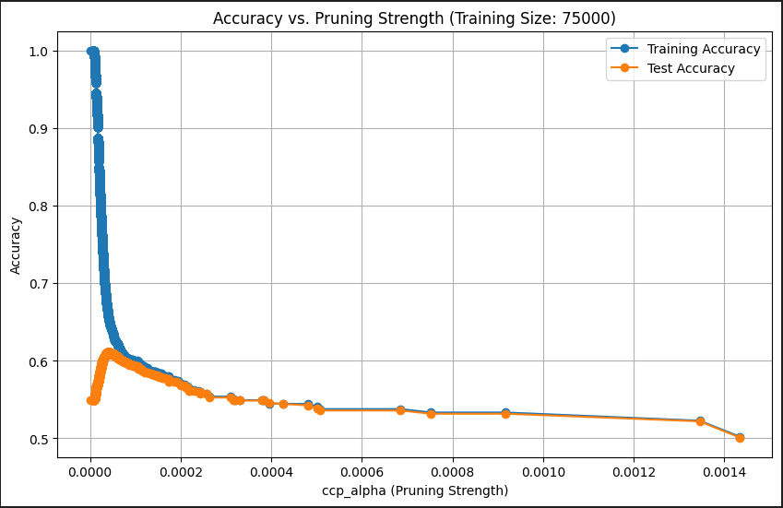


Decision Trees
Pre-Processing
Challenges Encountered
Findings
Algorithms

Slide 6
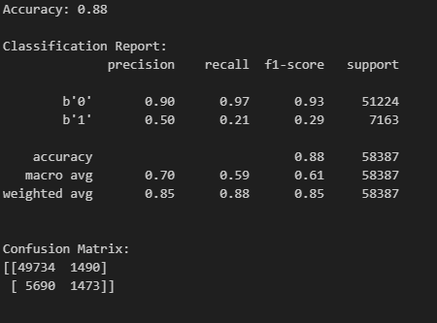
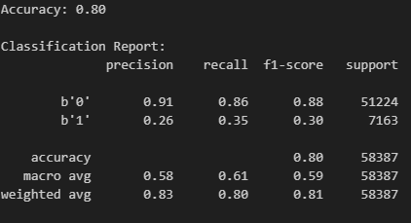
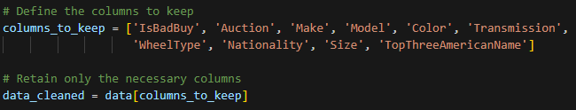
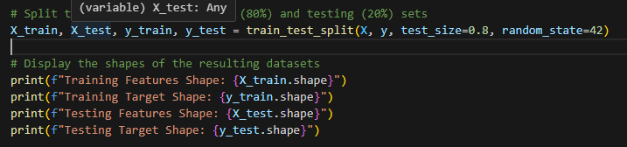
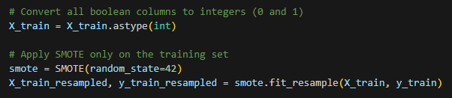
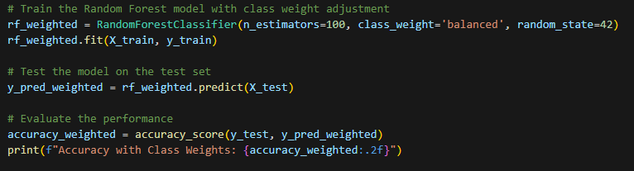
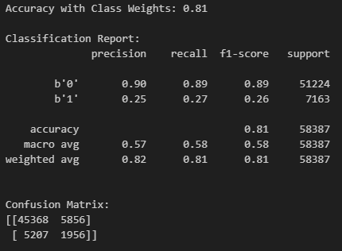
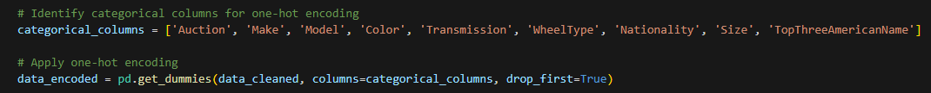


Random Forest
Pre-Processing
Challenges Encountered
Findings
Algorithms

Slide 7
Conclusion
Models Reviewed
Linear Regression
Decision Tree
Random Forest
What I Learned
Pruning Techniques
Handling Class Imbalance
Use of SMOTE
Feature Engineering
Technology Tools Used
Challenges Faced
Overfitting and Underfitting
Computational Limitations
Class Imbalance Issues

Slide 8
Thanks For Listening

